Slide 1


Business Simulation
Compete. Learn. Execute. LEAD
A Business Simulation For Leaders
Pre-simulation briefing

Slide 2
Managers are
IDIOTS…? (disagree…sure)

Slide 3
Some managers are
IDIOTS…?
(may be…?)
(19 managers…)

Slide 4
Some are
Brilliant…strategists?
(definitely…)

Slide 5
Why, only some…

Slide 6

The Best Way to Learn About Business:
Run a Business!
Capstone® developed originally for corporate clients, including General Electric, General Motors, Motorola, Caterpillar, and Honeywell.
Thereafter at Harvard, Wharton, Kellogg, Michigan and several other leading business schools.
============================================
In India – IIMA, IIMB, IIFT, SP JAIN, XIMB etc.
- TCS, Infosys, L&T, Asian Paints, Pepsi, GE, Kotak etc.

Slide 7
CAPSTONE®- From expert manager to Strategist/Business Leader
Since 1986
Over 100,000 people in 2008
Several Fortune500
More than 550 business schools
Over 70% market share

Slide 8

6 Teams in an Industry (Andrews, Baldwin, Chester…)
$100 mil business as on 31/12/08
6 Functions
    R&D
    Marketing
    Production
    HR
    TQM
    Finance

Slide 9
Round 0 business status report
Revenue - $100mil, PAT - $4mil, Cont. Margin -28%
Stock - $34/-, Market Cap - $69mil, Bond rating – B,
Market Share – 17%, Products – 5, A/R & A/P – 30 days
Substandard plant, untrained staff
Unclear Finance and Business strategy
Low price realization, excess plant capacities
Inferior products
Products positioning, automation levels, pricing - all out of place
All the problems that a business can have
Ideal business conditions, no recession/inflation/stagflation

Slide 10

5 Market Segments
    Traditional (Age and Price)
    Low (Price and Age)
    ------------------------------------
    High (Positioning and Age)
    Performance (MTBF and Positioning)
    Size (Positioning and Age)
One product in each segment, five products.
Max. eight, three NEW product launches (NPD).
8 Rounds (One Financial Year = One Round)

Slide 11

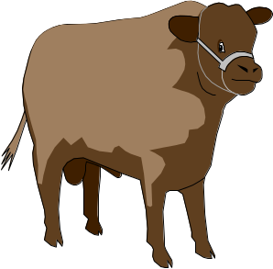

The Boston Consulting Group Growth-Share Matrix was developed in the 1960’s as a tool to assess a firm’s Strategic Business Unit (SBU) or product
Long-term success is achieved by having a mix of high-growth potential products that require lots of cash, and low-growth “cash cows” that generate the required $$
Market Share
High
Low
?
High
Market Growth
Low

Slide 12







Star products occupy strong positions in high growth markets
Cows occupy strong positions in low growth markets
Question Marks have low market share in segments with strong growth
Dogs are low market share products positioned in low potential markets

Slide 13


0 Round, $600mil
Industry grows @14% pa
By 8th round, it is over $1.7 bil pa market
30,000ft view & operational excellence have to go hand-in-hand
(SANTA SINGH---Carly Fiorina)

Slide 14

Dovetail your business strategy with financial objectives
Invest in Automation, TQM and Training
Raise capital; Debt, per se, is not bad
World class people & World class machines - go hand in hand
Plan production capacity in advance
Launch killer products (NPD) in the market place
A clear plan for each product- 3 to 4 years’ horizon (MARUTI)
Don’t let market drive your business, you drive the market, please
Competitive Intelligence analysis
All products’ names to begin with letter ‘C’…for Chester

Slide 15
Buying Criteria- page 5 (BIBLE)
- MTBF range is STATIC
Age requirement is STATIC
!!!!!!!!!!!!!!!!!!!!!!!!!!!!!!!!!!!!!!!!!!!!!!!!!!!!!!!!!!!!!!!!!!!!!!!!!!!!!!!!!
- Price range is DYNAMIC
- Positioning (size & performance) - DYNAMIC
All your decisions are driven by it.

Slide 16

Positioning = Performance and Size of the product
Performance increases - size reduces
Positioning: critical for High, Performance and Size segments
R&D projects should be completed within the SAME YEAR
Reverse R&D, yes, only with strategic intents
Each R&D project reduces product’s age by half
Important : please position all products in the Ideal spot every year
MTBF change is NOT R&D
Pages 12, 19, 20

Slide 17
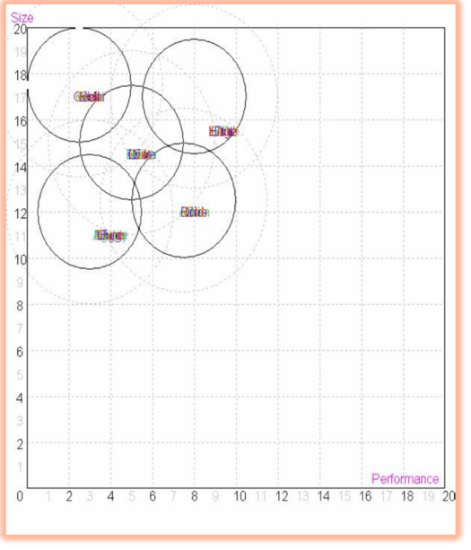
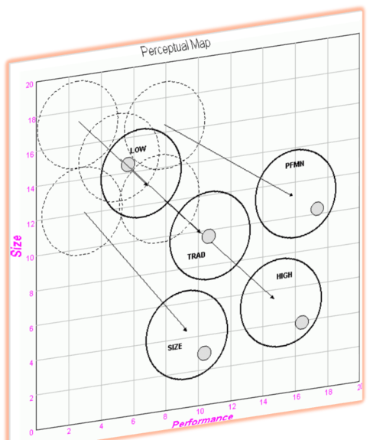
- Segments and Ideal spot drift as the rounds Progress.
- Drift Rates of High, Performance and
Size are faster.
- Each round the overlapping areas
between the segments become smaller.
Pages 4, 9 and 10

Slide 18

Promotion> awareness Sales> accessibility
No golden number, driven by competition and your sales forecast
High Promo and Sales budget do not mean high sales
High sales may not be high profits
Avoid price wars
Business is about PRICE DISCOVEYRY and VOLUME DISCOVERY
Increase market share without reducing price
A smart business will never give up On Margin
Pages 13/14

Slide 19

Dedicated plant capacity for each product
Min 150% plant utilization
Automation and New Capacity, available next year
Traditional - 8, Low - 10, High - 5, Performance/Size - 6
Level 10 automation, labor component 10%
Level 1 automation, labor component 90%
High dependence on labor = high production cost
High automation = longer R&D cycle, better contribution margin
Page 14

Slide 20
Production
Depreciation - 15yrs Straight Line method
Plant sale - $0.65 vs. $1/-
Capacity carry cost – 18% pa (Intt. + Depreciation)
Plant sale with unsold inventories - retain one unit
Two shift production
150% wages for overtime and second shift

Slide 21

Benefits immediate, and continue
Overall 10 TQM interventions
Not more than $2mil in a single intervention in a single year
Not less than $0.5mil in a single intervention in a single year
Brings about efficiencies, cost savings and minimizes errors
Little to do with innovation and customer satisfaction
TQM may be the panacea for some of the ills
Page 42

Slide 22
Human Resources
Training
Recruiting Spend
Productivity Index
Hiring/Firing
Overtime vs. Second Shift
Labor Negotiations (page 37)
Pages - 38 to 41

Slide 23
As on 31st Dec ’08
Traditional Statistics
Total Industry Unit Demand | 7,387
Actual Industry Unit Sales | 7,387
Segment % of Total Industry | 32.4%
Growth Rate | 9.2%
Traditional Customer Buying Criteria
 | Expectations | Importance
1. Age | Ideal Age = 2.0 | 47%
2. Price | $20.00 - 30.00 | 23%
3. Positioning | Pfmn 5.0 Size15.0 | 21%
4. Reliability | MTBF 14000-19000 | 9%

Slide 24
Create the orchestra across 8 parameters
Name | Market Share | Units Sold to Seg | Revision Date | Stock Out | Pfmn Coord | Size Coord | List Price | MTBF | Age Dec.31 | Promo Budget | Sales Budget | Customer Aware- ness | December Customer Survey
Able | 13% | 961 | 11/21/2005 |  | 5.5 | 14.5 | $28.00 | 17500 | 3.1 | $1,000 | $1,000 | 55% | 18
Baker | 13% | 961 | 11/21/2005 |  | 5.5 | 14.5 | $28.00 | 17500 | 3.1 | $1,000 | $1,000 | 55% | 18
Cake | 13% | 961 | 11/21/2005 |  | 5.5 | 14.5 | $28.00 | 17500 | 3.1 | $1,000 | $1,000 | 55% | 18
Daze | 13% | 961 | 11/21/2005 |  | 5.5 | 14.5 | $28.00 | 17500 | 3.1 | $1,000 | $1,000 | 55% | 18
Eat | 13% | 961 | 11/21/2005 |  | 5.5 | 14.5 | $28.00 | 17500 | 3.1 | $1,000 | $1,000 | 55% | 18
Fast | 13% | 961 | 11/21/2005 |  | 5.5 | 14.5 | $28.00 | 17500 | 3.1 | $1,000 | $1,000 | 55% | 18
Acre | 4% | 270 | 5/25/2004 |  | 3.0 | 17.0 | $21.00 | 14000 | 4.6 | $900 | $900 | 52% | 4
Bead | 4% | 270 | 5/25/2004 |  | 3.0 | 17.0 | $21.00 | 14000 | 4.6 | $900 | $900 | 52% | 4
Cedar | 4% | 270 | 5/25/2004 |  | 3.0 | 17.0 | $21.00 | 14000 | 4.6 | $900 | $900 | 52% | 4
Dell | 4% | 270 | 5/25/2004 |  | 3.0 | 17.0 | $21.00 | 14000 | 4.6 | $900 | $900 | 52% | 4
Ebb | 4% | 270 | 5/25/2004 |  | 3.0 | 17.0 | $21.00 | 14000 | 4.6 | $900 | $900 | 52% | 4
Feat | 4% | 270 | 5/25/2004 |  | 3.0 | 17.0 | $21.00 | 14000 | 4.6 | $900 | $900 | 52% | 4
Customer recall = Items in RED

Slide 25

Small marriage
Your business’ cutting edge interaction with the market place
Potential Demand Variables:
Revision Date
Performance
Size
Price
MTBF
Age
Promo Budget
Sales Budget
Customer Buying Criteria:
Price
Age
Positioning
MTBF
You want to be leader at least on TOP TWO of these in each segment.
Recall
Potential
Demand
Execution Excellence

Slide 26


Determine ‘Success Measurement Criteria’
Mission Statement
Business Strategy
Role Assignment

Slide 27

Individual Roles
Manage one function one round
One market segment one round
Competitive intelligence officer
Member to the Board of Directors
One CEO for each round
It’s your business, you decide…

Slide 28


Emergency Loan
Unsold inventory
Stock-out
Idle cash
Cash-flow mismatch

Slide 29


SALES FORECAST
Differentiator?...do you have one
Page 25

Slide 30


Automation vs. Market Segment vs. R&D cycle
Manpower hiring vs. Overtime vs. Second Shift
Long Term Debt vs. equity issue vs. Short Term Debt
$ spend on promo/sales channels vs. market segment

Slide 31




Capstone® Courier
Top Ten rankings worldwide (Capstone® Hall of Fame), (Round 8 Cumulative Profit/Stock Price - Dinner from Prof.?)
Round analysis
Relative ranking
Balanced Scorecard (Customer, Finance, Internal Business Process and Learning & Innovation)
Analyst Report- beyond accounting

Slide 32

Contribution Margin over 30% (EBIT)
Zero emergency loan
At least one unit per product line left unsold, AND not more than 60 days of inventory remaining per product at the end of the year.
(Second Dinner from Prof.?)
Increase in stock price over last year
Profit greater than zero

Slide 33


If ranked computer teams
below

Slide 34
Ideal spot
Ensures highest viewing, greater
chances of sales translation.
Sale depends upon MTBF, Age
Price, Awareness, Accessibility,
And Revision Date
$4.99 situation, when supply runs short on demand

Slide 35


As spacious inside as Ambassador
+
As small from outside as Zen
+
As fuel efficient as Maruti800 =
Indica
In Capstone®
Price & Age – not so savvy customer
Positioning & MTBF- highly savvy customer
Two products in the same segment catering to different constituencies

Slide 36
Business is about - diSrupTion
Britannica
Encarta
Wikipedia
a public toilet where you do not
know who has used it prior to you.
Next?
=============================================
Yahoo! Mail
Businesses spend money to offer a service FREE!

Slide 37


Business is about giving, day after day:
- Better product
At a cheaper price
While retaining/increasing profits

Slide 38
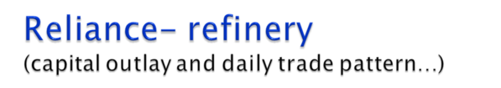
30,000ft- sets up a refinery (raw material purchase for textile from Indonesia)
Complex vs. normal
Complex is expensive, can refine any kind of crude
Skewed global refining capacity
Some crude variety always going cheap
Keeps half of its crude purchases open, and half hedged
Result - always in operation, efficient and great margins

Slide 39

Perceptual Map (product positioning)
Demand Analysis (sales forecast)
Capacity Analysis (sales forecast)
Margin Analysis (profitability)
Consumer Report (overall business performance)

Slide 40
Process
Organize your team to execute situation analysis
- 1-2 members to develop perceptual map
- 1-2 members to develop demand and capacity analysis
- 1-2 members to develop margin analysis
- 1-2 members to develop consumer report
Do a situation analysis for the market and your company
Report to one another on results of analysis
Practice Capstone tactics
Answer discussion questions in preparation for round debrief

Slide 41
Fortune at the bottom of pyramid!
- CK Prahalad
Coffee…Tea…Fag…

Slide 42
F of Finance
Connecting Finance to Business
Managers obtain GREAT performance appraisal reports,
while
companies have SINKING bottom lines?

Slide 43

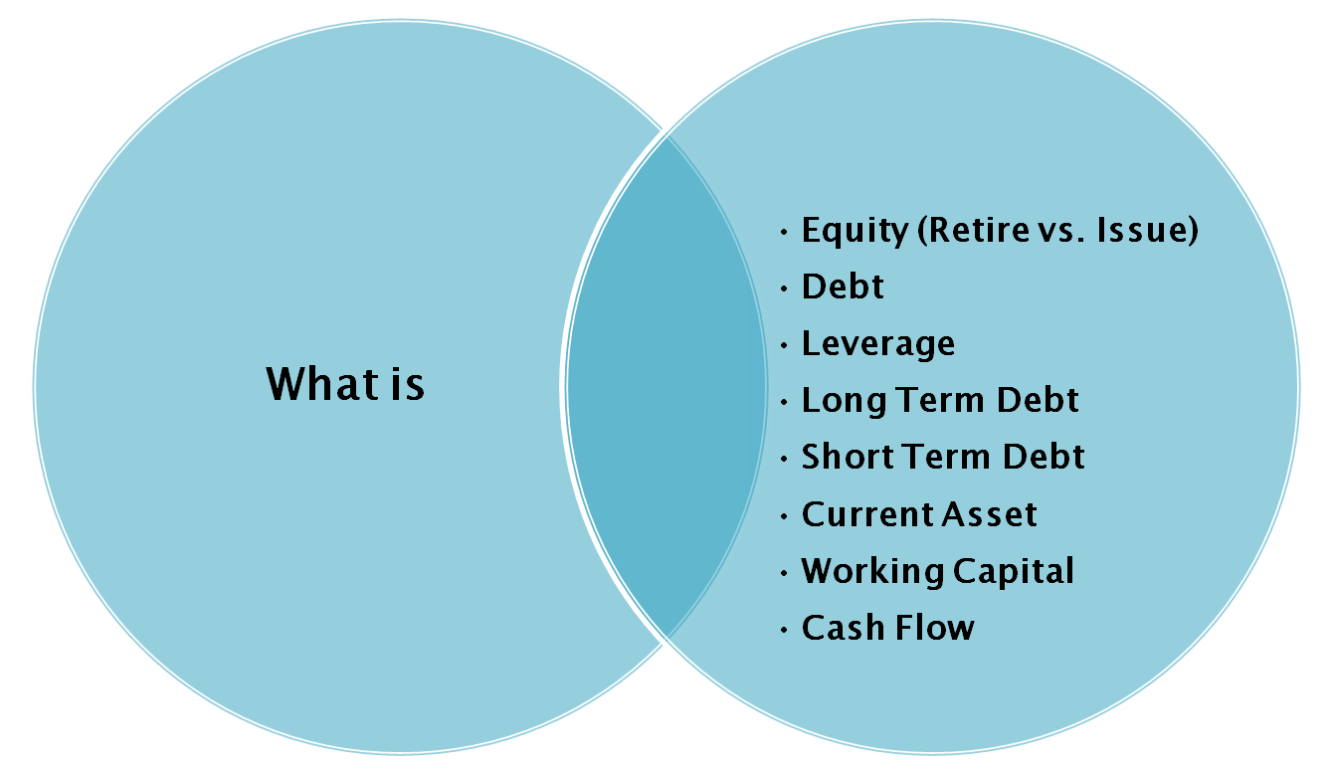

Slide 44

Business>Finance>Accounting
Finance is the Language of Business. Accounting is the Medium of Finance.
“Accounting is the identification, measurement and communication of financial information about economic entities to interested persons”
Kieso and Weygandt
  Arose from the need to communicate financial information

Slide 45

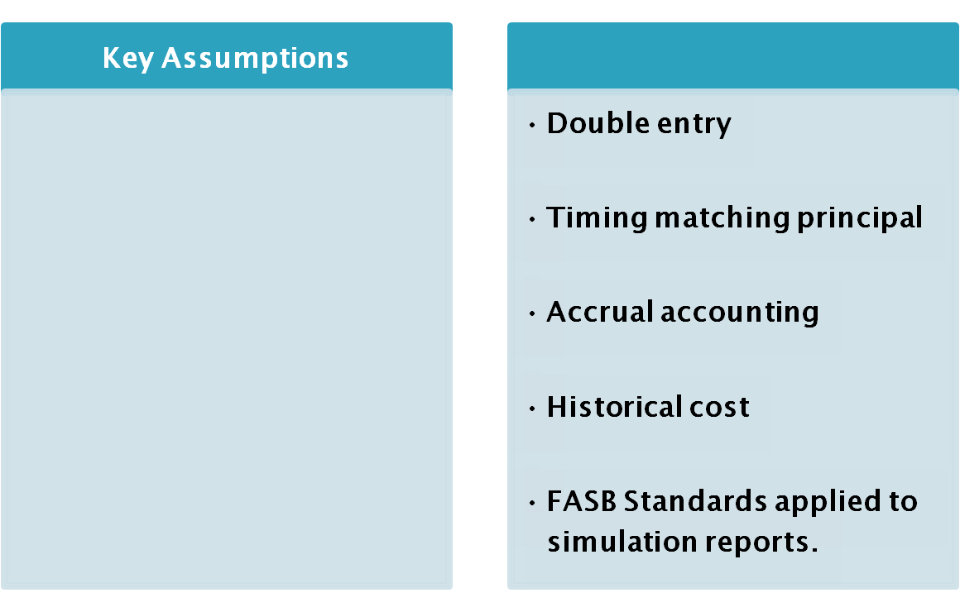

Slide 46

Know how effectively resources are obtained and appropriated
Use information to inform investment and credit decisions
Identify optimum time to take actions affected by cash flow
P&L
or Income Statement
Cash
Flow
Balance
Sheet

Slide 47

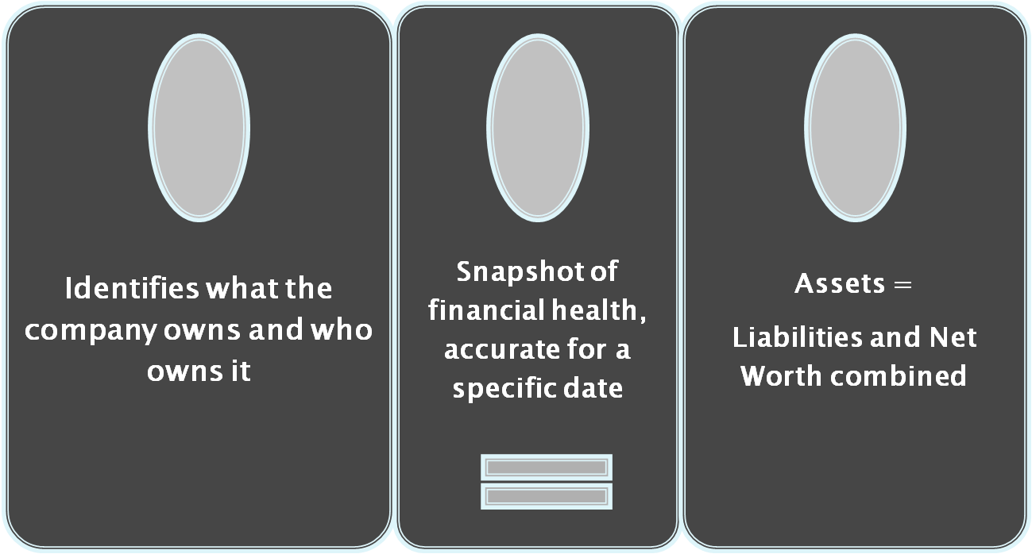

Slide 48
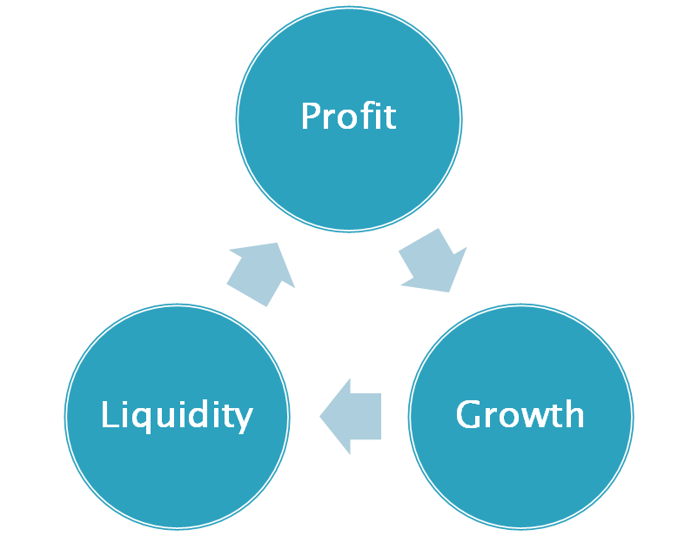
THE MOST IMPORTANT
?

Slide 49
Balance Sheet
Liabilities/sources
Assets/uses
Current Liabilities
(A/c Payables, Interest, Rent, Salaries)
1.00
Current Assets
(A/c Receivables, Cash, Raw Materials, Spares)
2.00
Loans (Banks, Friends, Relations etc.)
Fixed Assets
(Building, Machinery, Furniture)
Equity (Promoters, Public, Institutions)
Reserves (General, Share Premium) Intangible Assets
(Loss, goodwill)

Slide 50

A financial ratio shows the relationship between two financial measures
Developed by dividing one measure into another
Provide insights into company’s operations and strategy
Four categories: liquidity, solvency, market value, profitability
Used internally to evaluate performance and set goals
Used externally to make investment decisions

Slide 51
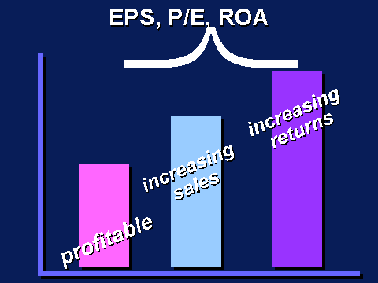

Slide 52
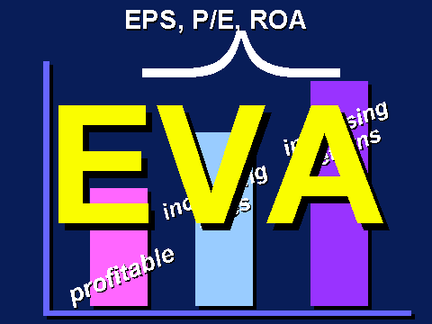

Slide 53
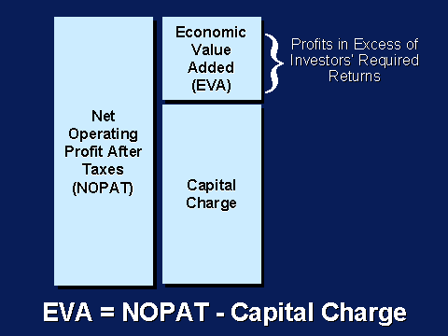

Slide 54

Value Chain
net profit
equity
Return on Equity =
net profit
sales
sales
assets
assets
equity
x
x

Slide 55

Value Chain
net profit
equity
Return on Equity =
net profit
sales
sales
assets
assets
equity
x
x

Slide 56

Value Chain
net profit
equity
Return on Equity =
net profit
sales
sales
assets
assets
equity
x
x
Return on Sales
Asset Turnover
Leverage

Slide 57

Current Assets = 1.29
Fixed Assets = 1.11
Sales = 4.07
Net Income = .37
Shareholder Equity = 1.16
Current Assets = 1.49
Fixed Assets = .84
Sales = 3.09
Net Income = .52
Shareholder Equity = 1.54
Turnover x 1.69
ROS 9.3%
= ROA 15.7%
x Leverage 2.07
= ROE 32.5%
Turnover x 1.33
ROS 16.9%
= ROA 22.4%
x Leverage 1.52
= ROE 33.8%
Texas Instruments
Hewlett Packard

Slide 58
You want to achieve this…
SALES
Maximum
PROFIT
Maximum
ROS
A
S
S
E
T
T/O
L
E
V
E
R
A
G
E
ASSETS
Least
EQUITY
Least

Slide 59
Your Financial GOALS
(Every business has clearly defined financial goals, and come
up with a dovetailing business strategy to achieve them.)

Slide 60

Success Measurement
Profit driven
ROS (Return on Sales) >>> %Gross Margin
ROE (Return on Equity) >>> Increasing Profit/Buy back equity
ROA (Return on Assets) >>> Increasing Profit/Low Asset base
Cumulative Profit >>> Overall Profit
Stock Price >>> Profit/Buy back equity/Div/expansion
Market Cap >>> Stock Price x Number of O/s shares
----------------------------------------------------------------------------------
Asset Turnover >>> High Sales/Low Asset base
Market Share >>> High Sales
Sales driven

Slide 61
Capstone®- Financial Decisions
Acquiring Capital through:
  Current Debt
  Stock Issue
  Bond Issue (Long Term Debt)
  Profit
Dividend policy, to maximize return to shareholders
Credit policy for customers/suppliers (A/R & A/P)
Driving the Financial structure (Leverage, Gearing)
Selecting performance measure, that support your strategy
Long term uses, long term sources. Short term uses, short term sources.

Slide 62

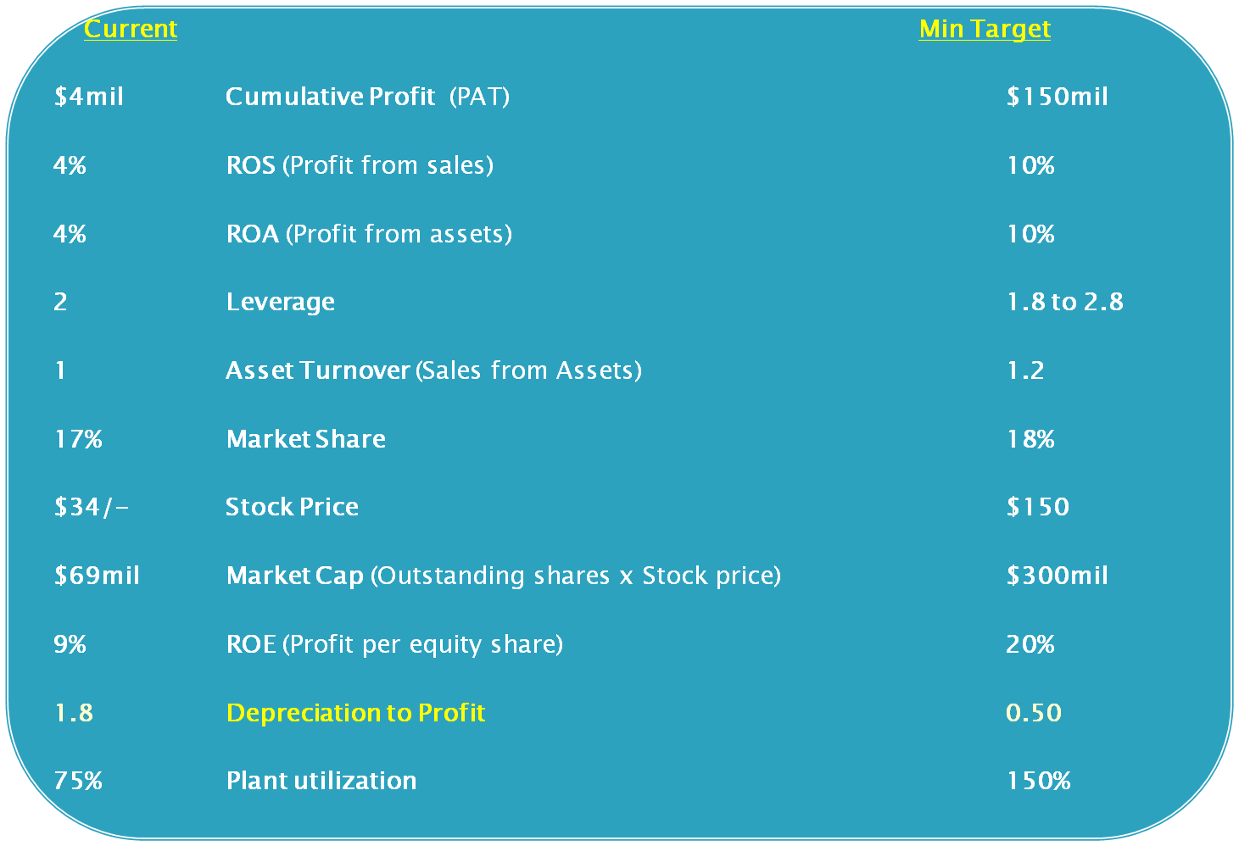

Slide 63

You want to achieve what you want, while giving customer what he wants.
Customer’s desires
Price
Age
Positioning
MTBF
Customer Buying
Criteria (Page 5)
Your BUSINESS
R&D, Marketing, Production, Finance, TQM, HR
Automation, Pricing, Awareness, Hiring,
Accessibility, Firing, Sales Forecast, A/R, Debt, A/P, Asset purchase etc.
Your Desires
ROE, ROA, ROS
A T/o, Market Share
Market Cap
Stock Price
Profit
Success Measurement
Criteria

Slide 64
Strategy
(alright…let us call it business strategy…)
What is strategy…anyway?

Slide 65
STRATEGY
Strategy and Tactics differ mainly around time scale.
In Capstone®, a 5-8 year Strategy is supported with annual tactical decisions.
Strategic Plan might consist of:
Vision or Mission Statement
S.W.O.T. Analysis (or Environmental and Internal scans)
Tactical and Functional Area Plans

Slide 66

From where in the organization STRATEGY should emerge?
Michael Porter argues for a top-down view. Strategy is designed at the top of the organization, with the goal of positioning resources and building relationships in a unique way.
vs.
Eric Banabeau says strategy should emerge from the bottom-up in a sort of dance with the marketplace, and that the goal of strategy should be to apply simple rules.
Wikipedia

Slide 67
STRATEGY- one of four organizational time drivers.
Mission Statement
(timeless)
Strategy
(3-5 years)
Operational Intents
(1 year)
Tactics
(Day to day)
TIME IN YEARS

Slide 68

STRATEGY
Mission Statement
Strategies are declared in corporate mission statements
Capstone® firms may develop and execute any strategy (or none at all - though that isn’t advisable).
INDUSTRY AND MARKET
ANALYSIS
S.W.O.T Analysis
Competitor Analysis
Competitive Analysis
Cultural & Political Planning
Human Strategy Business Resource Planning
Planning
Technology Planning
Strategy combines the output from four planning processes
PERFORMANCE
ASSESSMENT
Success Measurements
Analyst Report
Round Analysis - Star
Summary
FUNCTIONAL PLANNING
R&D
Marketing
Production
HR
Finance
TQM

Slide 69

High
Firms with
High ROI / Low Overall Market Share
would likely have a
clearly defined focused strategy
ROI
I-Flex, BOSE
Suzlon
Low
High
Market Share

Slide 70
Strategy- Porter Curve (ROI vs. Market Share)
High
High Overall Market Share / High ROI
firms would likely have a strong position in all segments –
risky, but effective when executed properly
ROI
GE, TATA, Reliance
High
Low
Market Share

Slide 71
High
Firms in the Middle have a
less definable identity,
and a hard time competing. They might have a number of “sofa-bed” product lines: Not great sofas – not great beds.
ROI
Amex
Low
High
Market Share

Slide 72

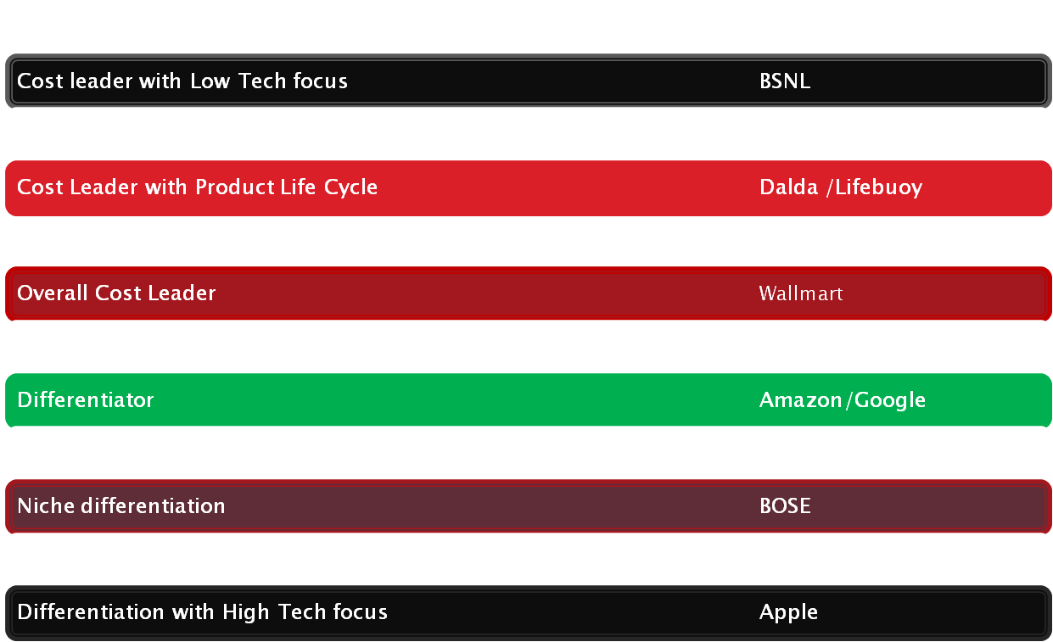
Strategies
Page 23-26

Slide 73

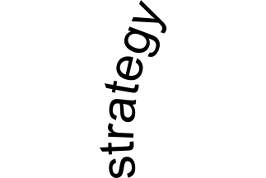
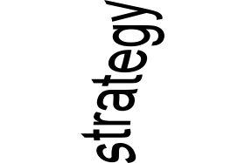
Today’s shift is tomorrow’s nightmare
Poor tactics undermine a good strategy
Good tactics can overcome a poor strategy
Sharad Pawar

Slide 74
Strategic Inflection Point (SIP)

Slide 75
Strategic Inflection
Point
G
R
O
W
T
H
“SIP is a time in
the life of a business when its fundamentals
are about to change”
T I M E

Slide 76
SIP creators
Sound… to silent movies
Word Processor… to Typewriter
NSE… to local stock exchanges
IBM’s purchase of PWC… to other IT biggies
Dell… to other PC manufacturers
Japanese… to Intel (memory chips)

Slide 77
Intel- SIP victim to SIP creator
    - Japanese memory chips… to Intel
    - Intel’s microprocessors… to IBM’s Mainframe
Gang wars…
and
Passerby (IBM).
Wither Change
Management!

Slide 78
Strategic Inflection
Point
Vijay Amritraj
G
R
O
W
T
H
“SIP is a time in
the life of a person when his/her fundamentals
are about to change”
Bjorn Borg
T I M E

Slide 79
Capstone® SIP
G
R
O
W
T
H
Strategic Inflection
Point
T I M E

Slide 80
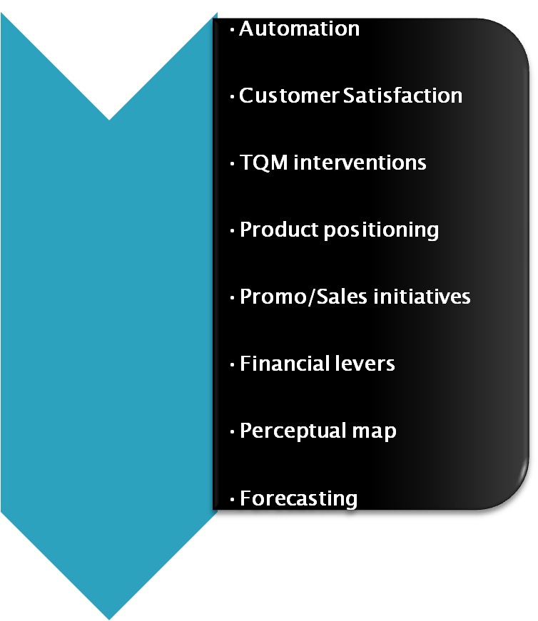
SIP creators (in Capstone®)

Slide 81
Red ocean
Compete in existing market space
Beat the competition
Exploit existing demand
Make the value/cost trade-off
Align the whole system of a
company’s activities with its strategic
choices of differentiation OR low cost
Blue ocean
Create uncontested markets
Make the competition irrelevant
Create and capture new demand
Break the value/cost trade-off
Align the whole system of a
company’s activities in pursuit of
differentiation AND low cost
Blue Ocean Strategy - W. Chan Kim & Renee Mauborgne
(An HBR publication)

Slide 82

1995-96
USD30bil revenue
Cash flow USD1bil
Stock at USD40/-
P/E of a bottler
Beverages, Friday/Tuesday, Bottling
No products from 5am to 10am!!!
Restaurant open only for 14hrs
Sold Tuesday/Friday, KFC etc. (value USD10bil)
Revenue down USD20bil
Sold bottling business (USD7bil)
Revenue down USD13bil
Bought Tropicana, Gatorade, Quaker Oats
Revenue up USD2Obil
Cash flow USD3bil
Focus on wellness

Slide 83
Bank of America – Kenneth Lewis
Settled Enron and Worldcom issues
Cut 10,000 jobs
Outsourced back office work to India
New Tower at Times Square
Aspires – branch network, ubiquitous ATMs, free online Bill paying
Six Sigma, from Manufacturing
La Salle, from ABN; Fleet Boston; MBNA Corp; US Trust; Chinese Credit Card
No-fee mortgage program, Free online stock trade, Loss Leaders
ATM charge fee $3, a transaction
Over 50% revenue from Fee income
Picked up Countrywide
Market Cap trebled greater than JP Morgan, Citigroup
‘I had no Ivy League background, no blue blood parents. Yet this company allowed me to compete.’
Reported for duty, picked a house, informed his wife – in that order.

Slide 84
Three rules- please break them
Necessity is the mother of invention
Change management
Do not keep all your eggs in one basket
Invention is the mother of necessity
Do not manage change- create the change, you CANNOT manage change
Please keep all your eggs in one basket (core competence)
Jeff Immelt

Slide 85
Cassandras within
Amtrex…
Account clerk’s doubt!

Slide 86
Forbes100 from 1917 to 1987: 39 members of the Class of ’17 were alive in ’87; 18 in ’87 F100; 18 F100 “survivors” underperformed the market by 20%; just 2 (2%), GE & Kodak, outperformed the market 1917 to 1987.
S&P 500 from 1957 to 1997: 74 members of the Class of ’57 were alive in ’97; 12 (2.4%) of 500 outperformed the market from 1957 to 1997.
Source: Dick Foster & Sarah Kaplan, Creative Destruction: Why Companies That Are Built to Last Underperform the Market

Slide 87
“Good management was the most powerful reason [leading firms] failed to stay atop their industries.
Precisely because these firms listened to their customers, invested aggressively in technologies that would provide their customers more and better products of the sort they wanted, and because they carefully studied market trends and systematically allocated investment capital to innovations that promised the best returns, they lost their positions of leadership.”
Clayton Christensen, The Innovator’s Dilemma
Henry Ford- faster horses

Slide 88
“The ‘surplus society’ has a surplus of similar companies, employing similar people, with similar educational backgrounds, coming up with similar ideas, producing similar things, with similar prices and similar quality.”
Kjell Nordström and Jonas Ridderstråle, Funky Business

Slide 89
Distinct … or … Extinct
IBM advert- unique, matchless, incomparable… … …unrivalled

Slide 90
Unique businesses
Harley Davidson
Ebay
Ferrari
Victoria’s secrets
Swami Ramdev
Mallika Sherawat

Slide 91
“Organize” for … performance & customer satisfaction.
“Disorganize” for … renewal & innovation.

Slide 92
“You do not merely want to be the best of the best. You want to be considered the only ones who do what you do.”
Jerry Garcia
60% 70% 80% 90%
Lycos> Alta-vista>> MSN >>> Yahoo! @#%!*$+ Google

Slide 93
“The short road to ruin is to emulate the methods of your adversary.” — Winston Churchill
Avoid price war trap.

Slide 94
“Companies have defined so much ‘best practice’ that they are now more or less identical.”
Jesper Kunde, Unique Now ... or Never
==============================
Hence, you want to
THINK WEIRD: The High Standard Deviation Enterprise.

Slide 95
Saviors-in-Waiting
Disgruntled Customers
Off-the-Scope Competitors
Rogue Employees
Fringe Suppliers
Wayne Burkan, Wide Angle Vision: Beat the Competition by Focusing on Fringe Competitors, Lost Customers, and Rogue Employees

Slide 96
COMPETITORS: “The best swordsman in the world doesn’t need to fear the second best swordsman in the world; no, the person for him to be afraid of is some ignorant antagonist who has never had a sword in his hand before; he doesn’t do the thing he ought to do, and so the expert isn’t prepared for him; he does the thing he ought not to do and often it catches the expert out and ends him on the spot.”
Mark Twain
Dell- PC business
Google- Search
Satyam- Indian IT?

Slide 97
Recardo Semler (www.semco.com)
The key to management is to get rid of the managers.
The key to getting work done on time is to stop wearing a watch.
The best way to invest corporate profits is to give them to the employees.
The purpose of work is not to make money. Its purpose is to make the workers, whether working stiffs or top executives, feel good about life.
5. You, please fix salary, budget, target, promotion, sacking…
6. No managers AND no vision/mission statement

Slide 98
“UPS used to be a trucking company with technology. Now it’s a technology company with trucks.” —Forbes

Slide 99
“I never, ever thought of myself as a businessman.
I was interested in creating things I would be proud of.” —Richard Branson

Slide 100
Only the paranoid survive!
- by Andrew Grove
=======================================================
…the rest shall be condemned to seek out ‘Art of Living’!, Deepak Chopra, Shiv Khera, Paulo Coelho…
worse… participate in… KBC!

Slide 101

There is no magic bullet strategy in Capstone®.
Successful teams will develop a cogent long range plan,
align their internal functions in support of the plan, and adjust as
dictated by the opportunities and realities of the market place.
    (Competitive Intelligence + 30,000 ft view +
    Operational Excellence + Group dynamism)
Higher Awareness > Greater Choices > Smarter Decisions > Better Results

Slide 102
Discover
How different industry conditions support different types of strategies
How industry conditions change and the implication of those changes for strategic management
How organizations develop and maintain capabilities that lead to sustained competitive advantage
How companies overcome SIP (Strategic Inflection Point)
How to align Business Strategy and Financial goals

Slide 103
So what are we looking at…
Highest gap between price and cost
Least promo/sales dollar> max awareness/accessibility
Lowest asset base> highest sales/profit
Sales> highest profit
Better product, cheaper price, greater profit
Forecasting Forecasting Forecasting

Slide 104


Guys who take L O N G E R time
DO NOT make
Smarter Decisions

Slide 105


BREAK TIME
Charge up…

Slide 106
Keep in touch…
Dharam
sansrisk1@yahoo.com
www.sansrisk1.com
+91 - 98850 - 13550

